Slide 1


Analysis of Olympic History of Athletes and Results
Participants
Manoj Kumar Mukka,
Sai Kishore Reddy Tangella,
Nilesh Narayan Patil.

Slide 2
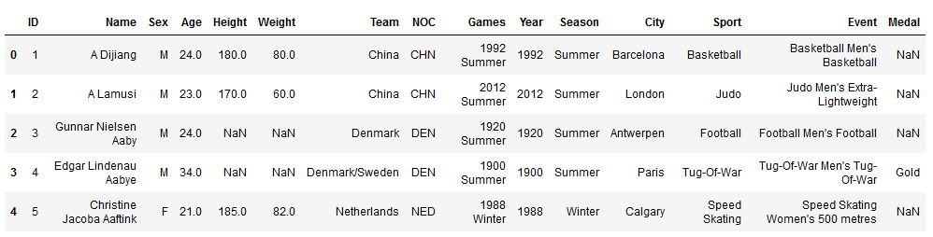
Overview of Athlete Event Data
Below Dataset represents the summary of athlete data.

Slide 3
Data Analysis Tools:
Tool | Purpose | Libraries
Python | To import, analyze and generate graphs from the data | Pandas, NumPy, Matplotlib, seaborn
Excel | Quick Data View
Jupyter Notebook | To generate documentation
Tableau | To import, analyze and generate graphs from the data

Slide 4
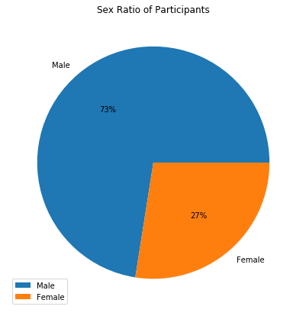
Data Analysis based on Gender and Age
Following Pie chart depicts sex ratio of participants.
This data is between year 1896 to 2016
It shows total 73% male and 27% female athletes has been participated between year 1896 to 2016.

Slide 5
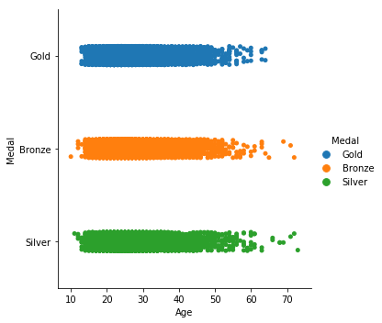
Athletes Winning Medals Categorized by Age
Next graph is illustration of athletes winning medals categorized by Age
Medals has categorized in gold, bronze, sliver. And Age between 10 to 70 years.

Slide 6
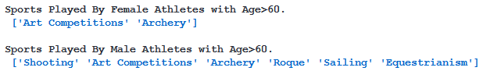
Data Analysis on Games Played by Athletes Having Age greater than 60
As per the graph we are seeing that there were athletes who were older than 60 years and won the medals !
Following summary represents the games in which these senior athletes won the medals. Also it is categorized by gender.

Slide 7
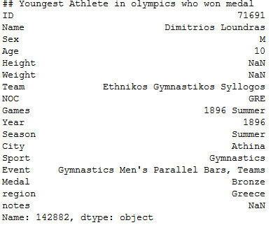
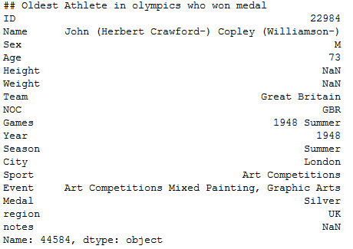
Analysis on Youngest and Oldest Athlete in Olympics Who Won Medal
Following is summary of youngest and oldest athlete in Olympics who won medal

Slide 8
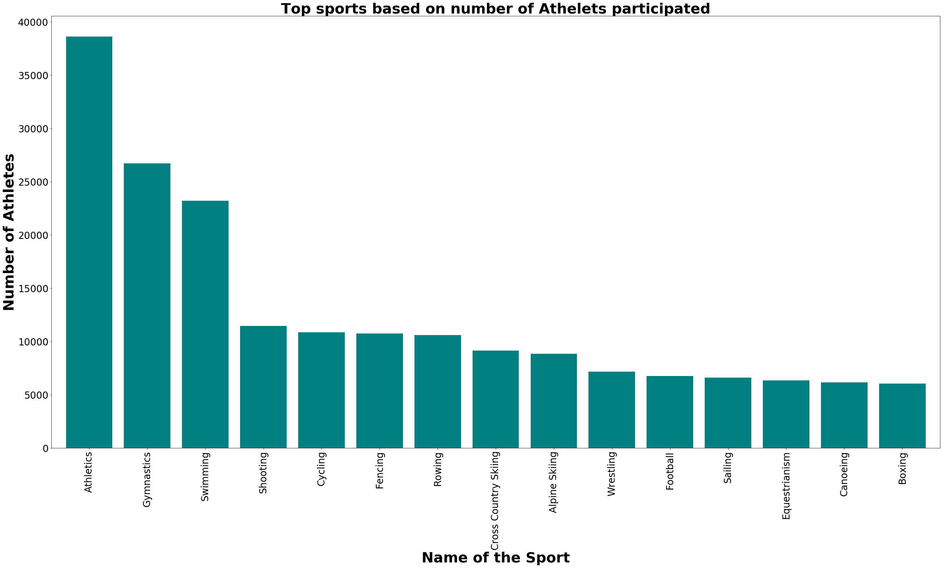

Slide 9
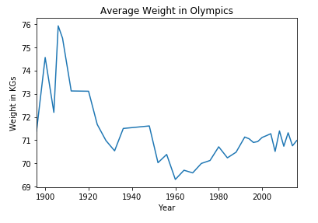
Data Analysis Based on the Weight and Height
Athletes Weight Data Analysis

Slide 10
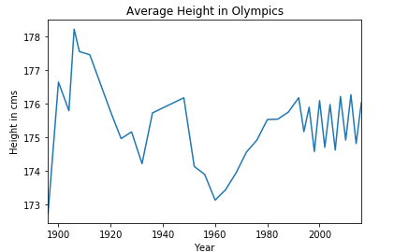
Data Analysis Based on the Weight and Height
Athletes Height Data Analysis

Slide 11
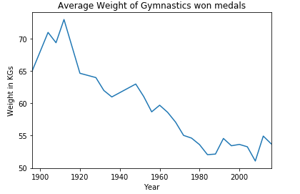
Data Analysis on Gymnastic Game in Olympics
Average Weight of Gymnastics won medals

Slide 12
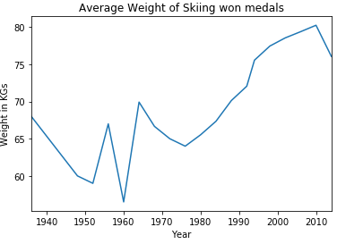
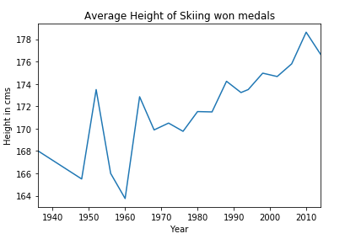
Data Analysis on Skiing Game in Olympics
Average Weight of Skiing won medal
Average Height of Skiing won medal

Slide 13
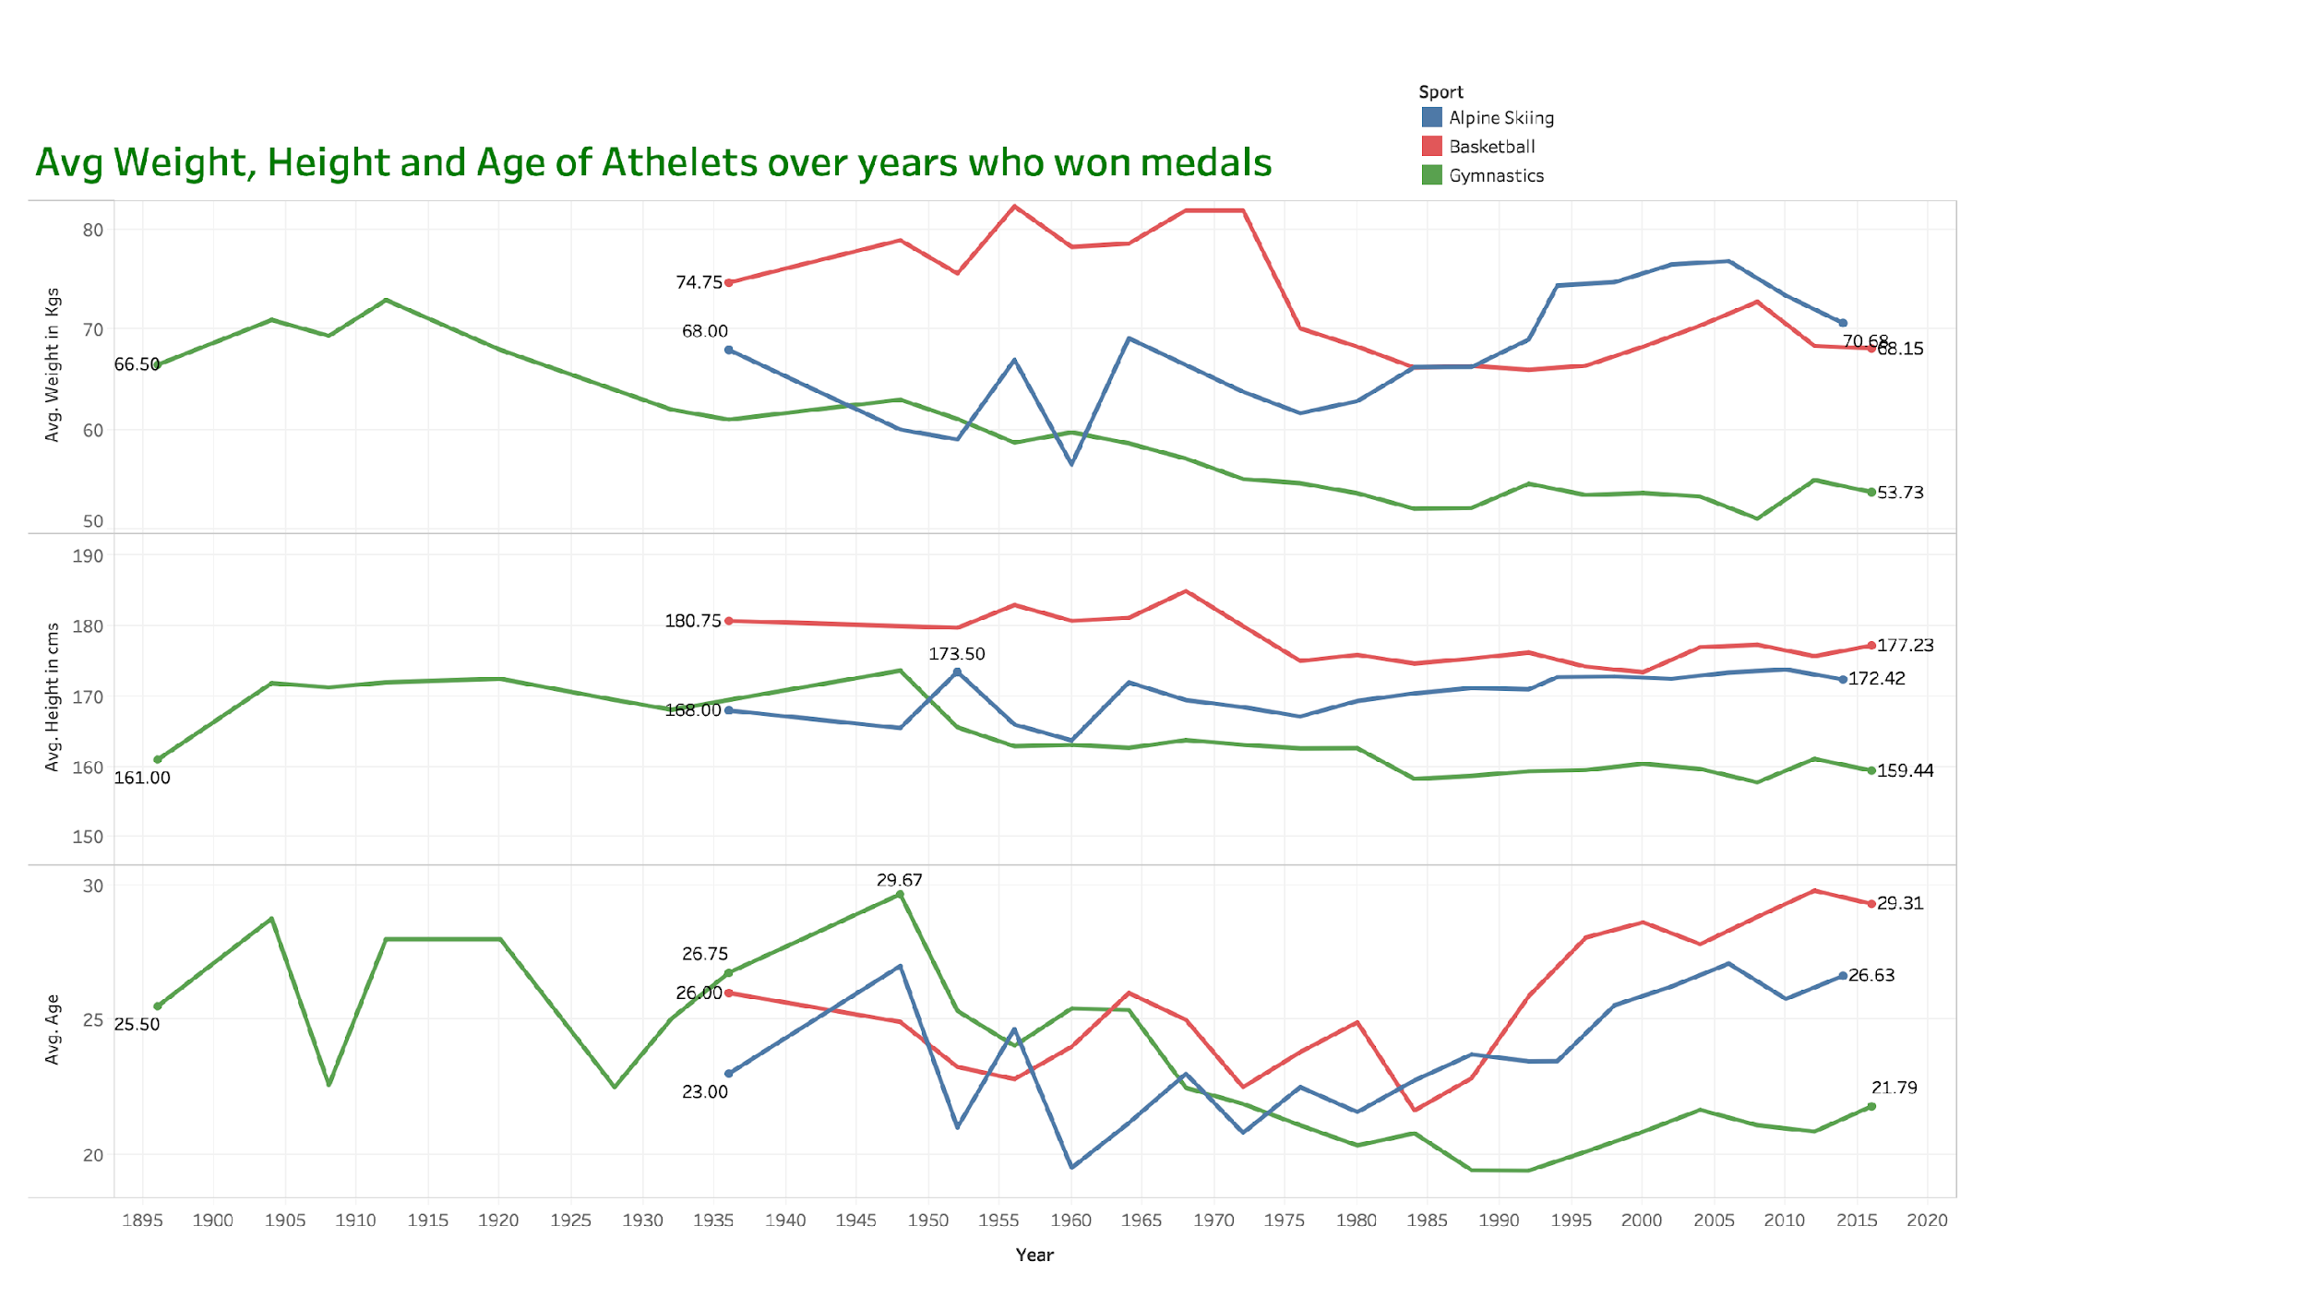

Slide 14
Data Analysis on Average Weight, Height and Age of winning athletes.
The average weight seen decreasing for the sports gymnastics and basketball while it is increasing for skiing this is because skiing need more weight for speed.
Similarly the average height seen decreasing for gymnastics and increasing for skiing, this is because gymnastics need stability which can be achieved by having less height.
The age pattern can be little unjudged because people may become more experienced by time can also become weak by age.

Slide 15
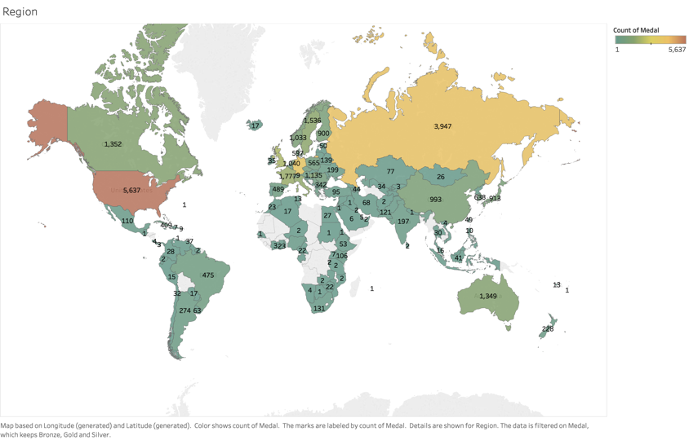
Number of Medals won by different countries

Slide 16
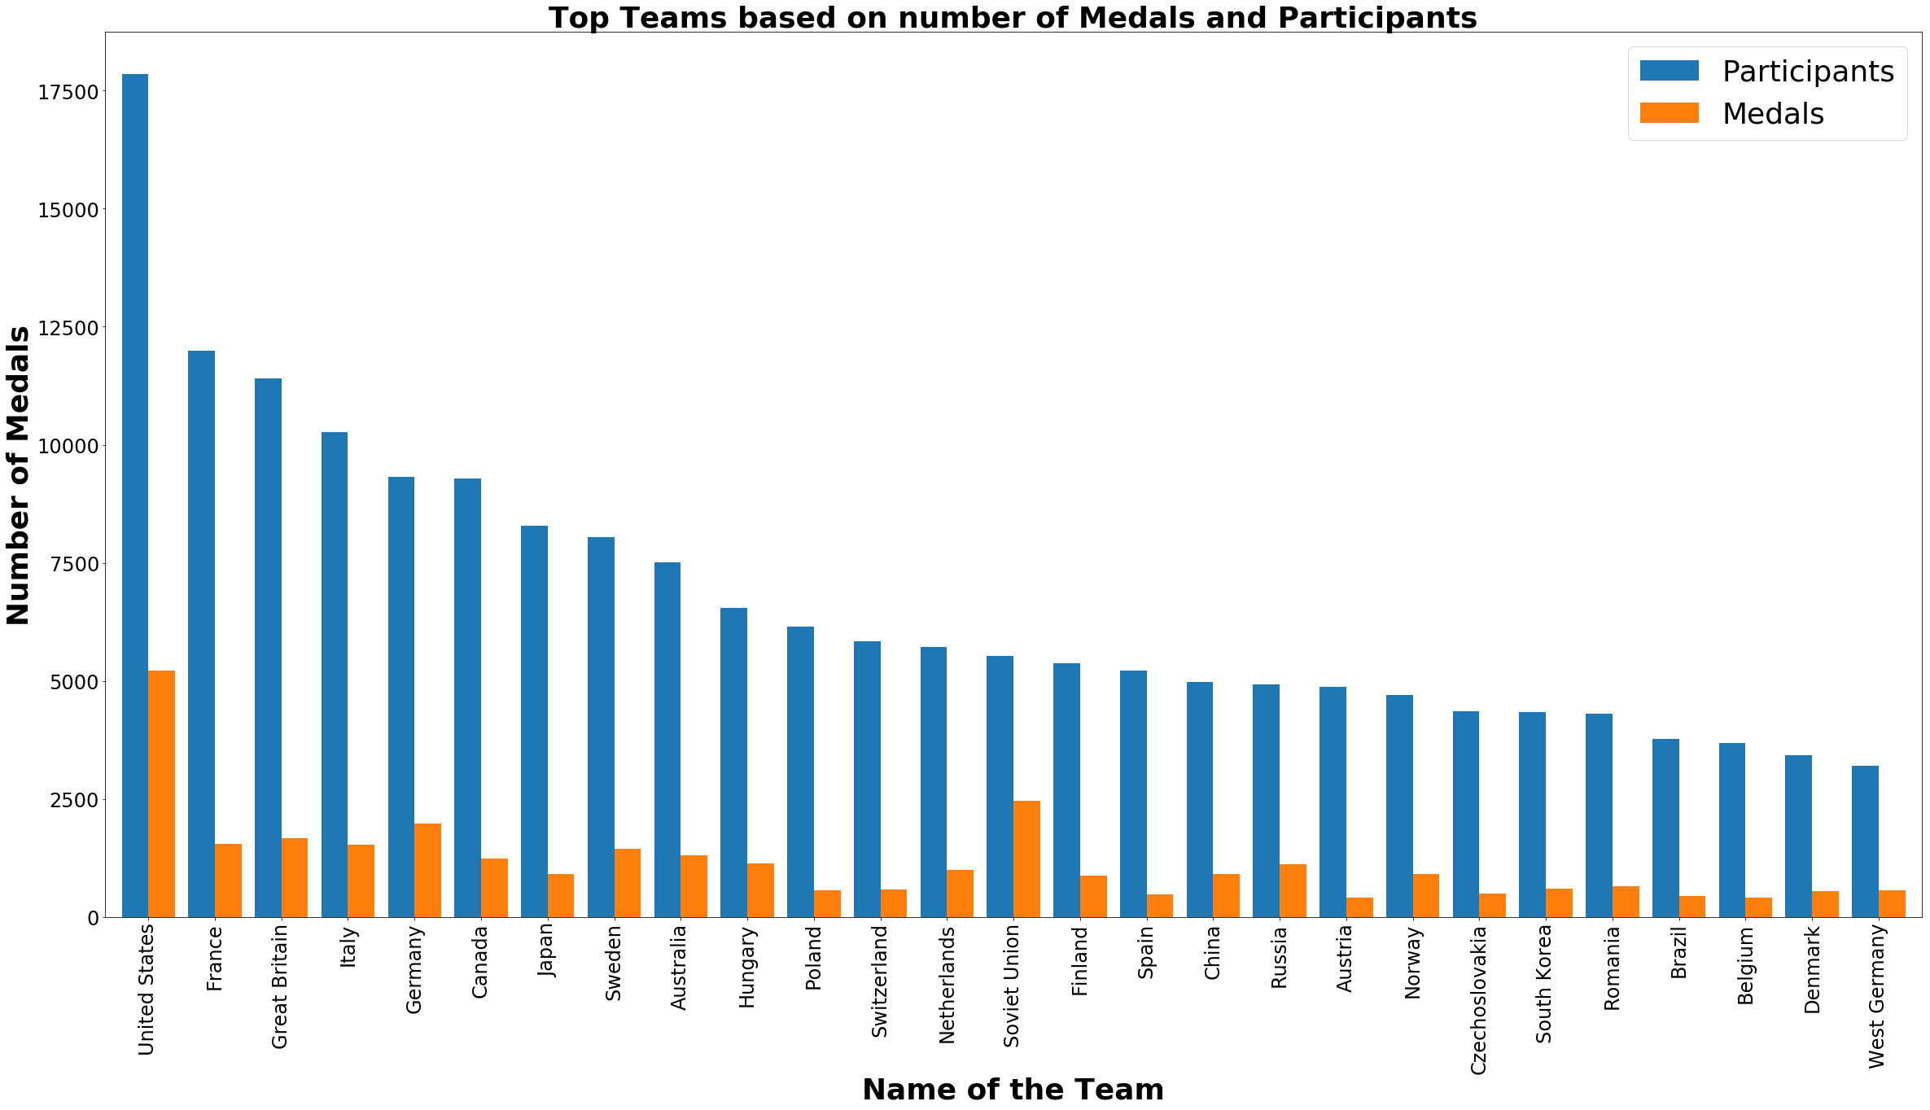

Slide 17
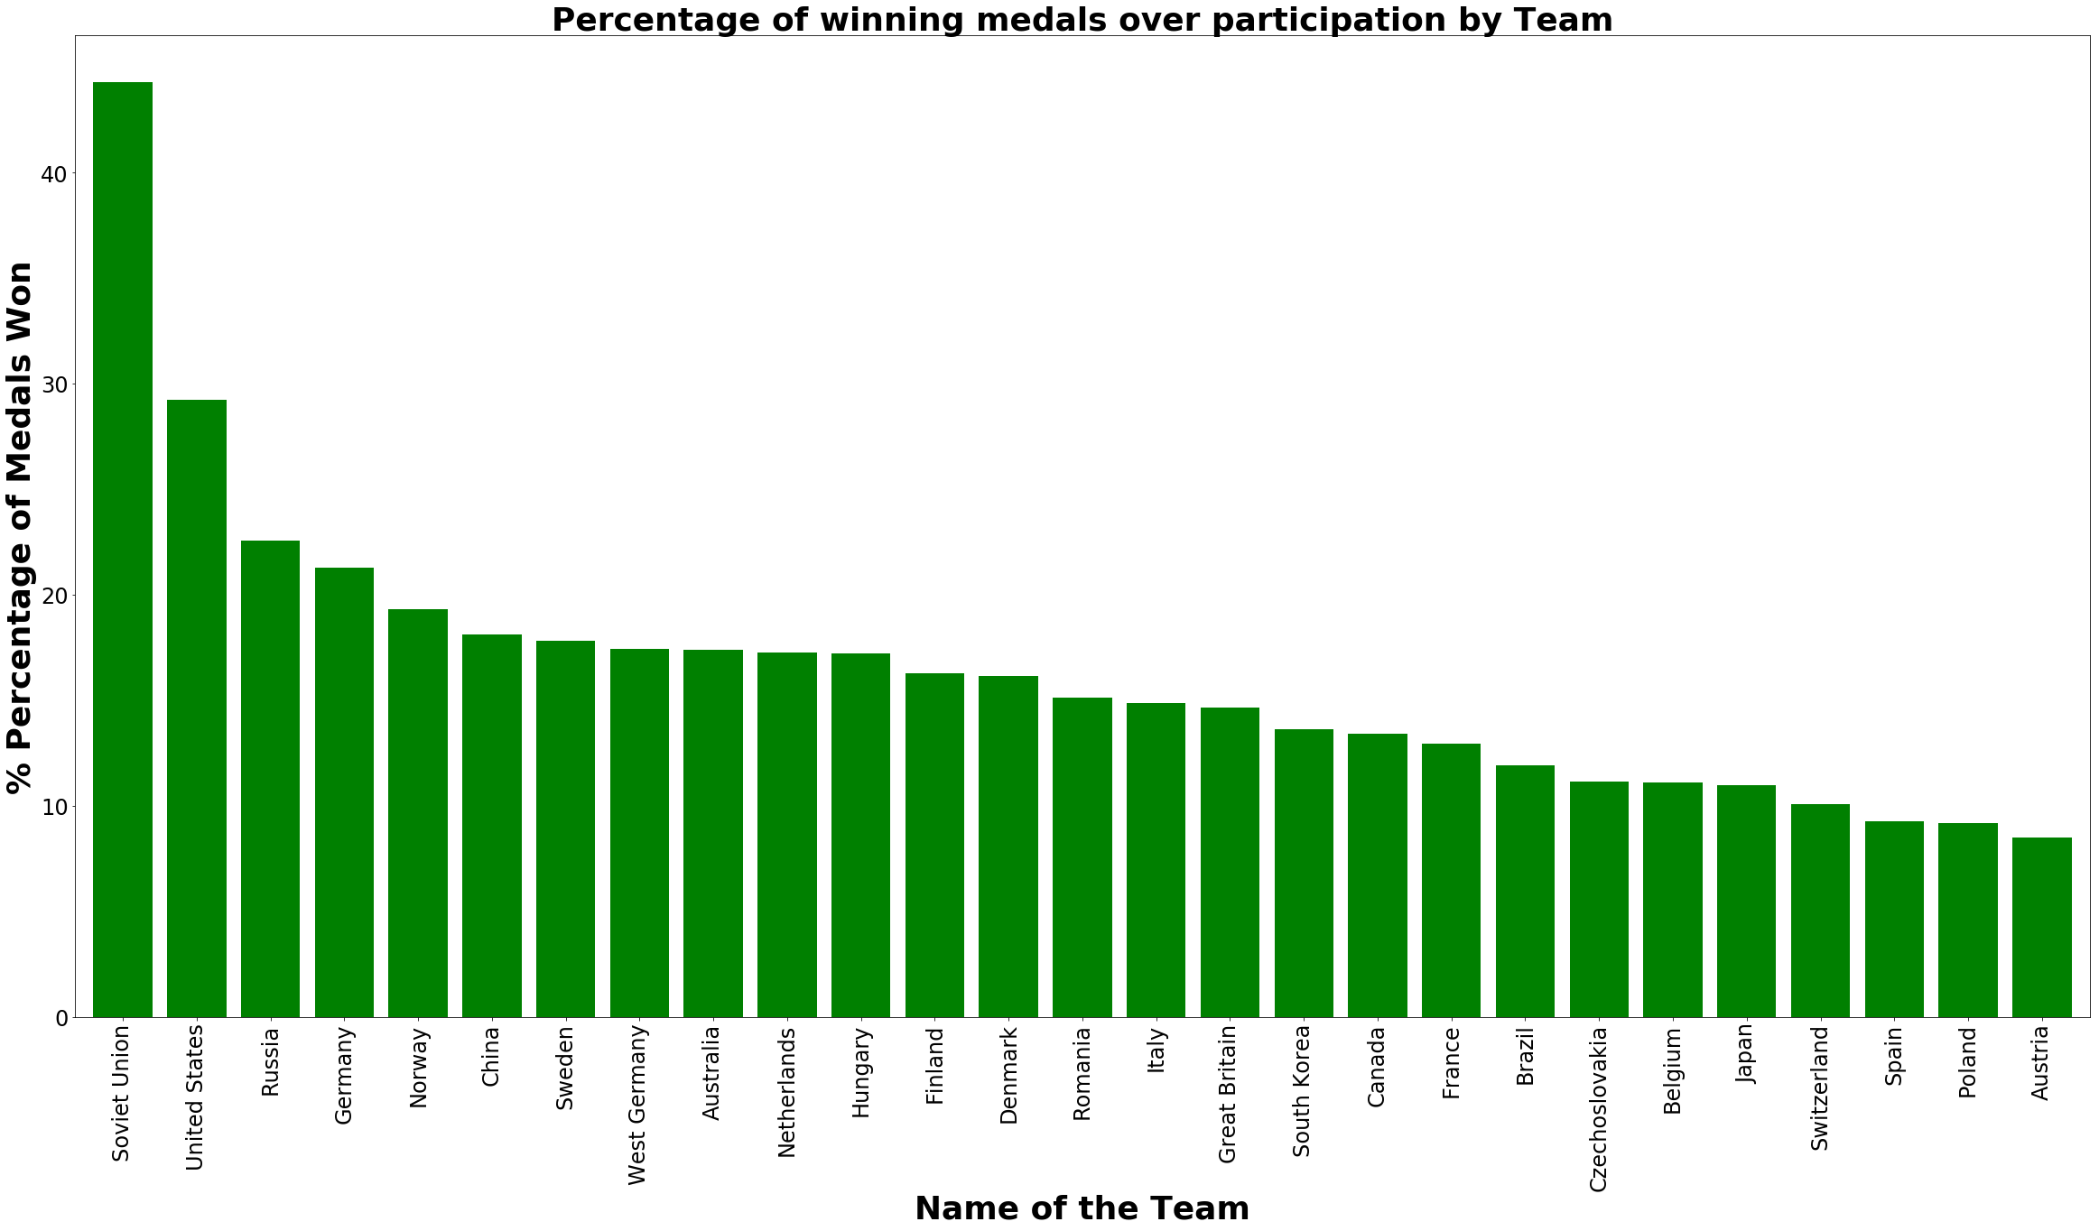

Slide 18
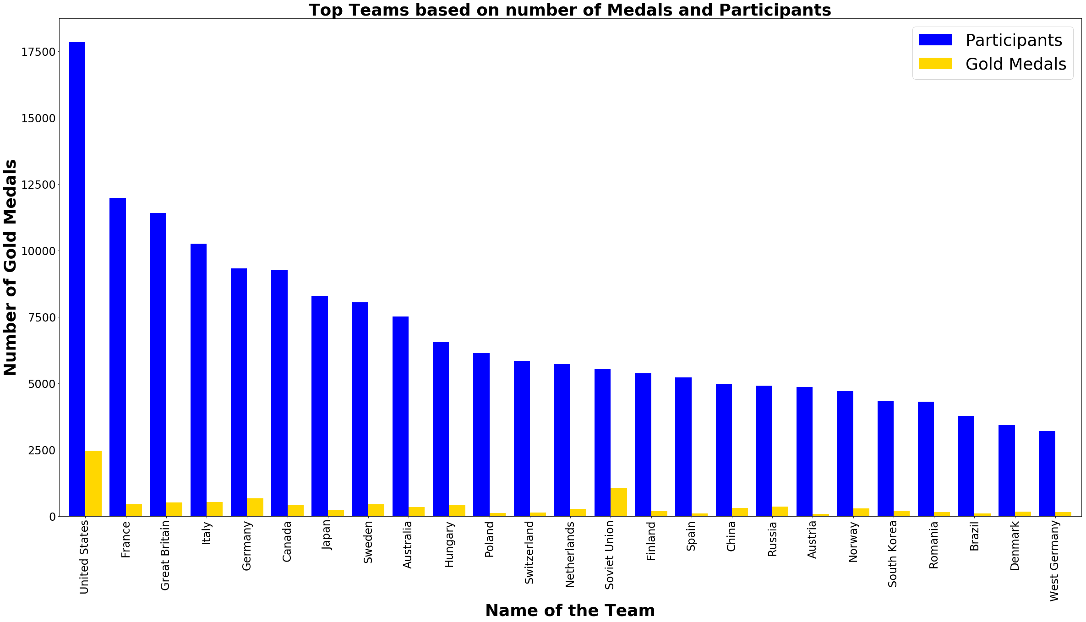

Slide 19
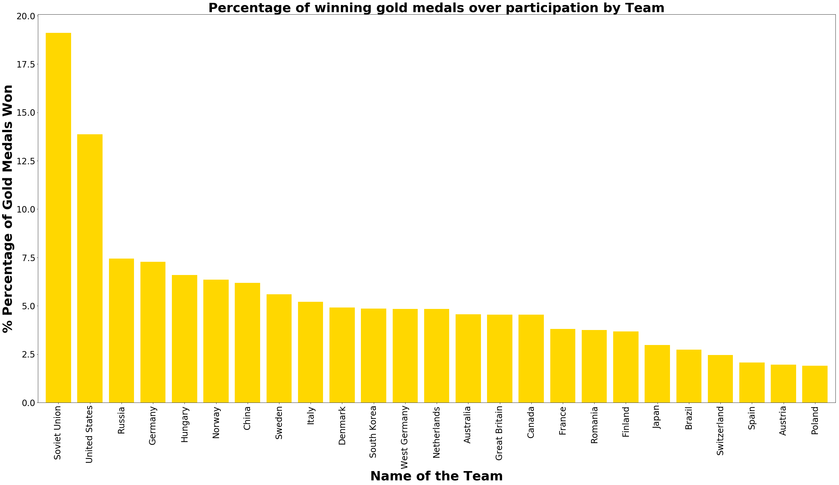

Slide 20
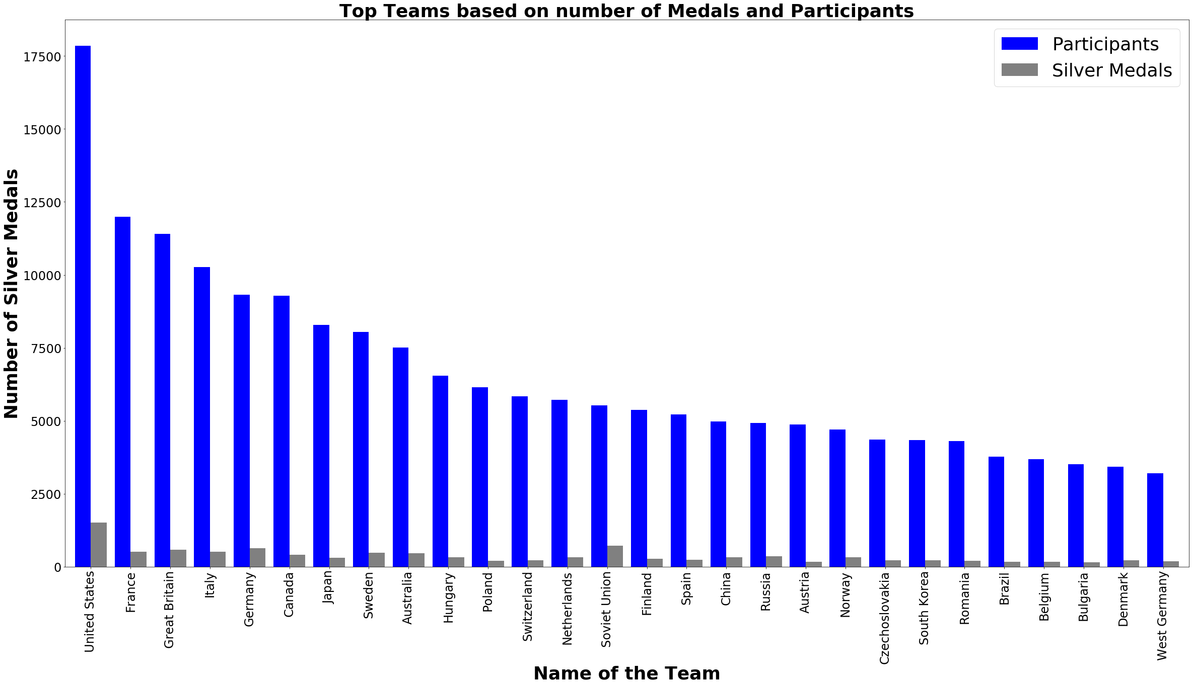

Slide 21
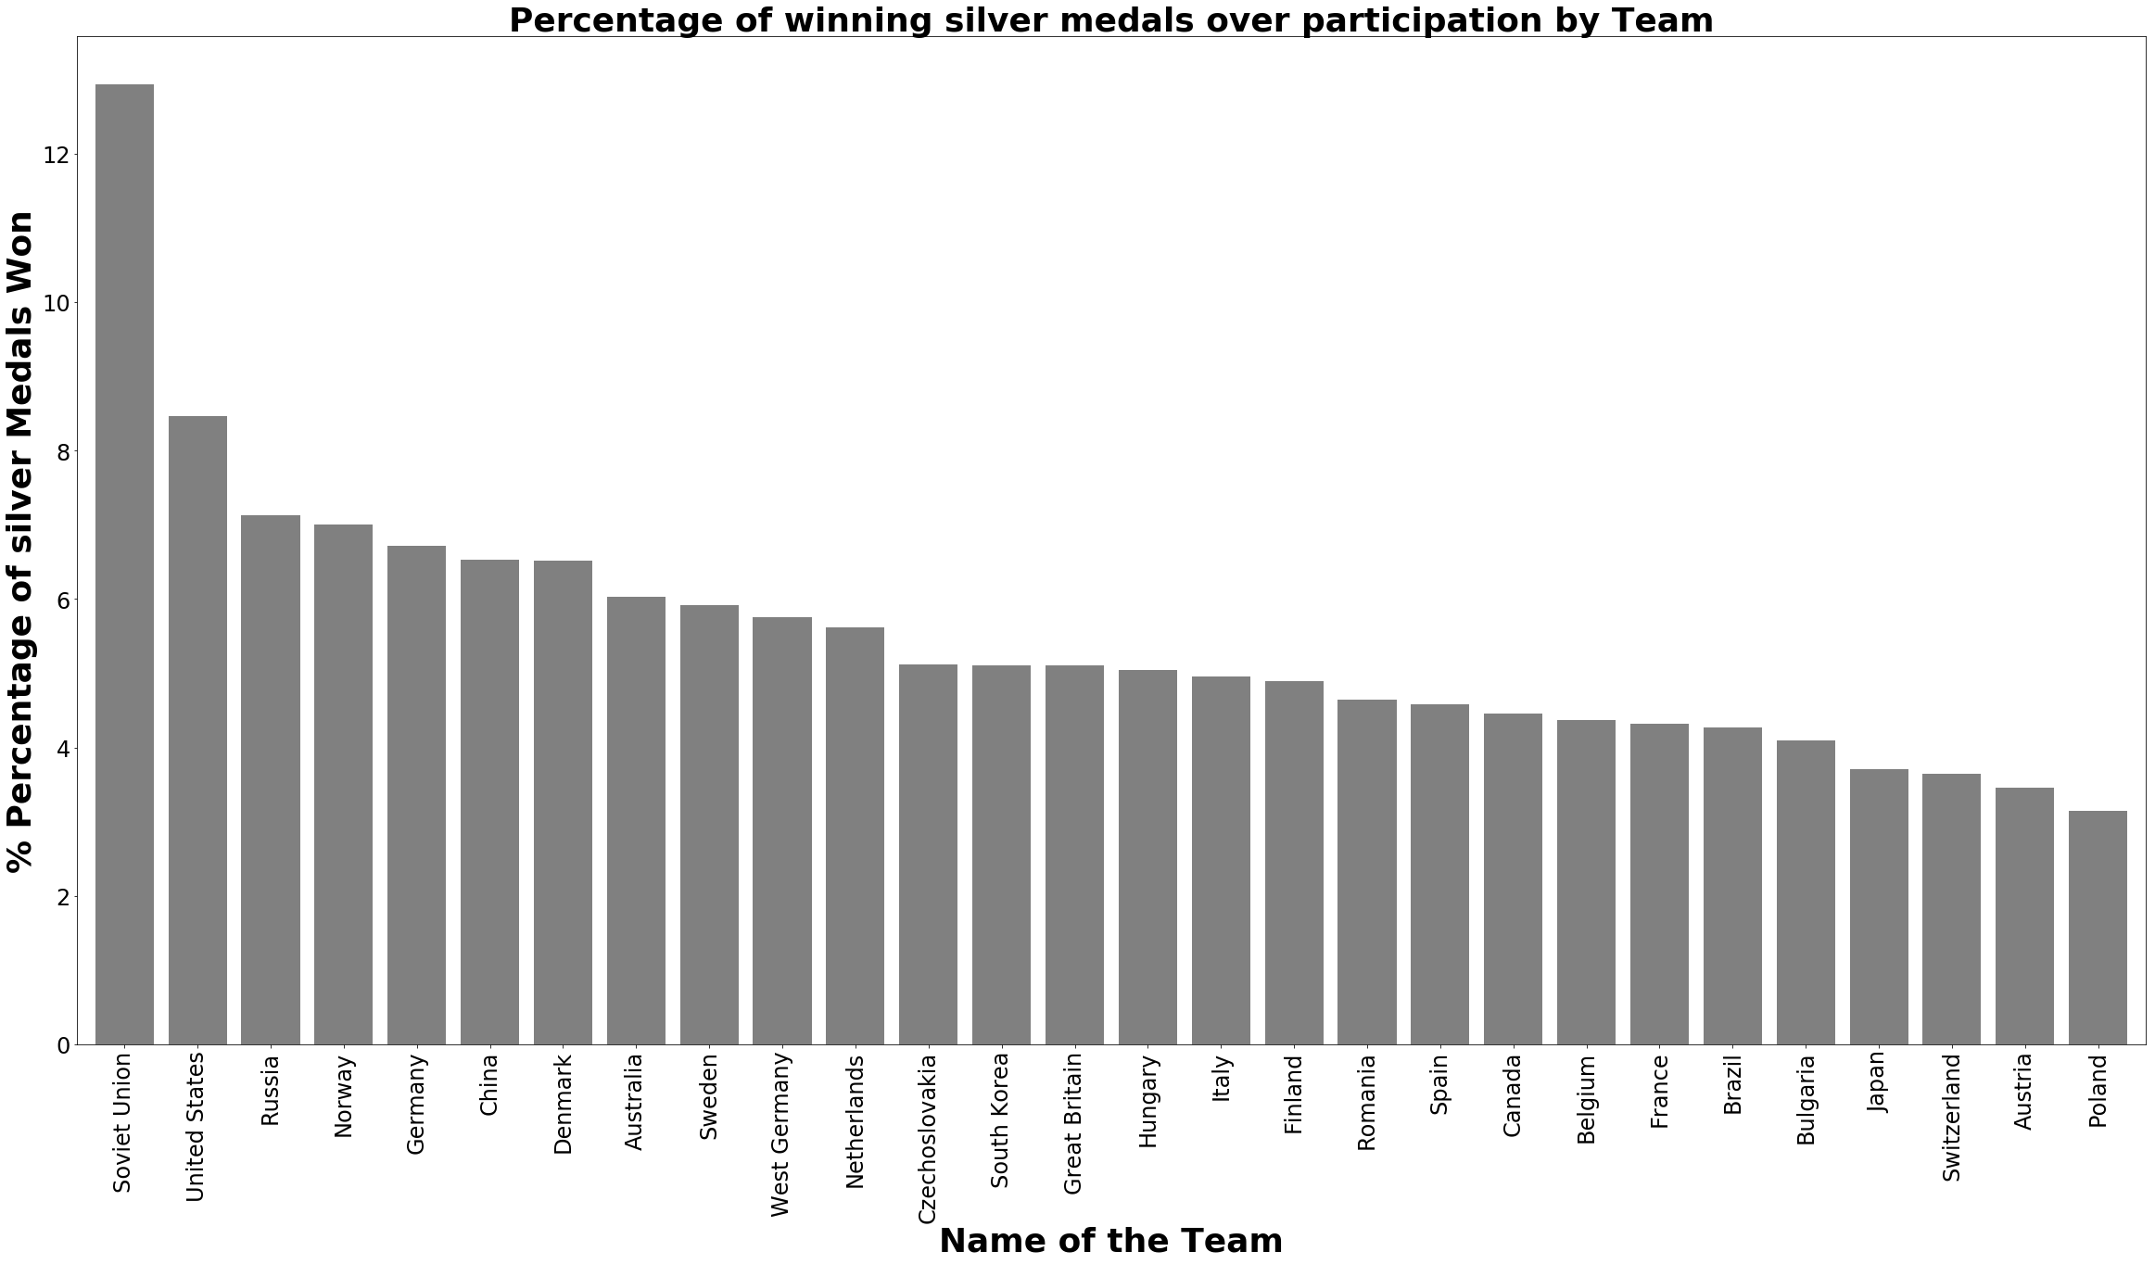

Slide 22


Slide 23
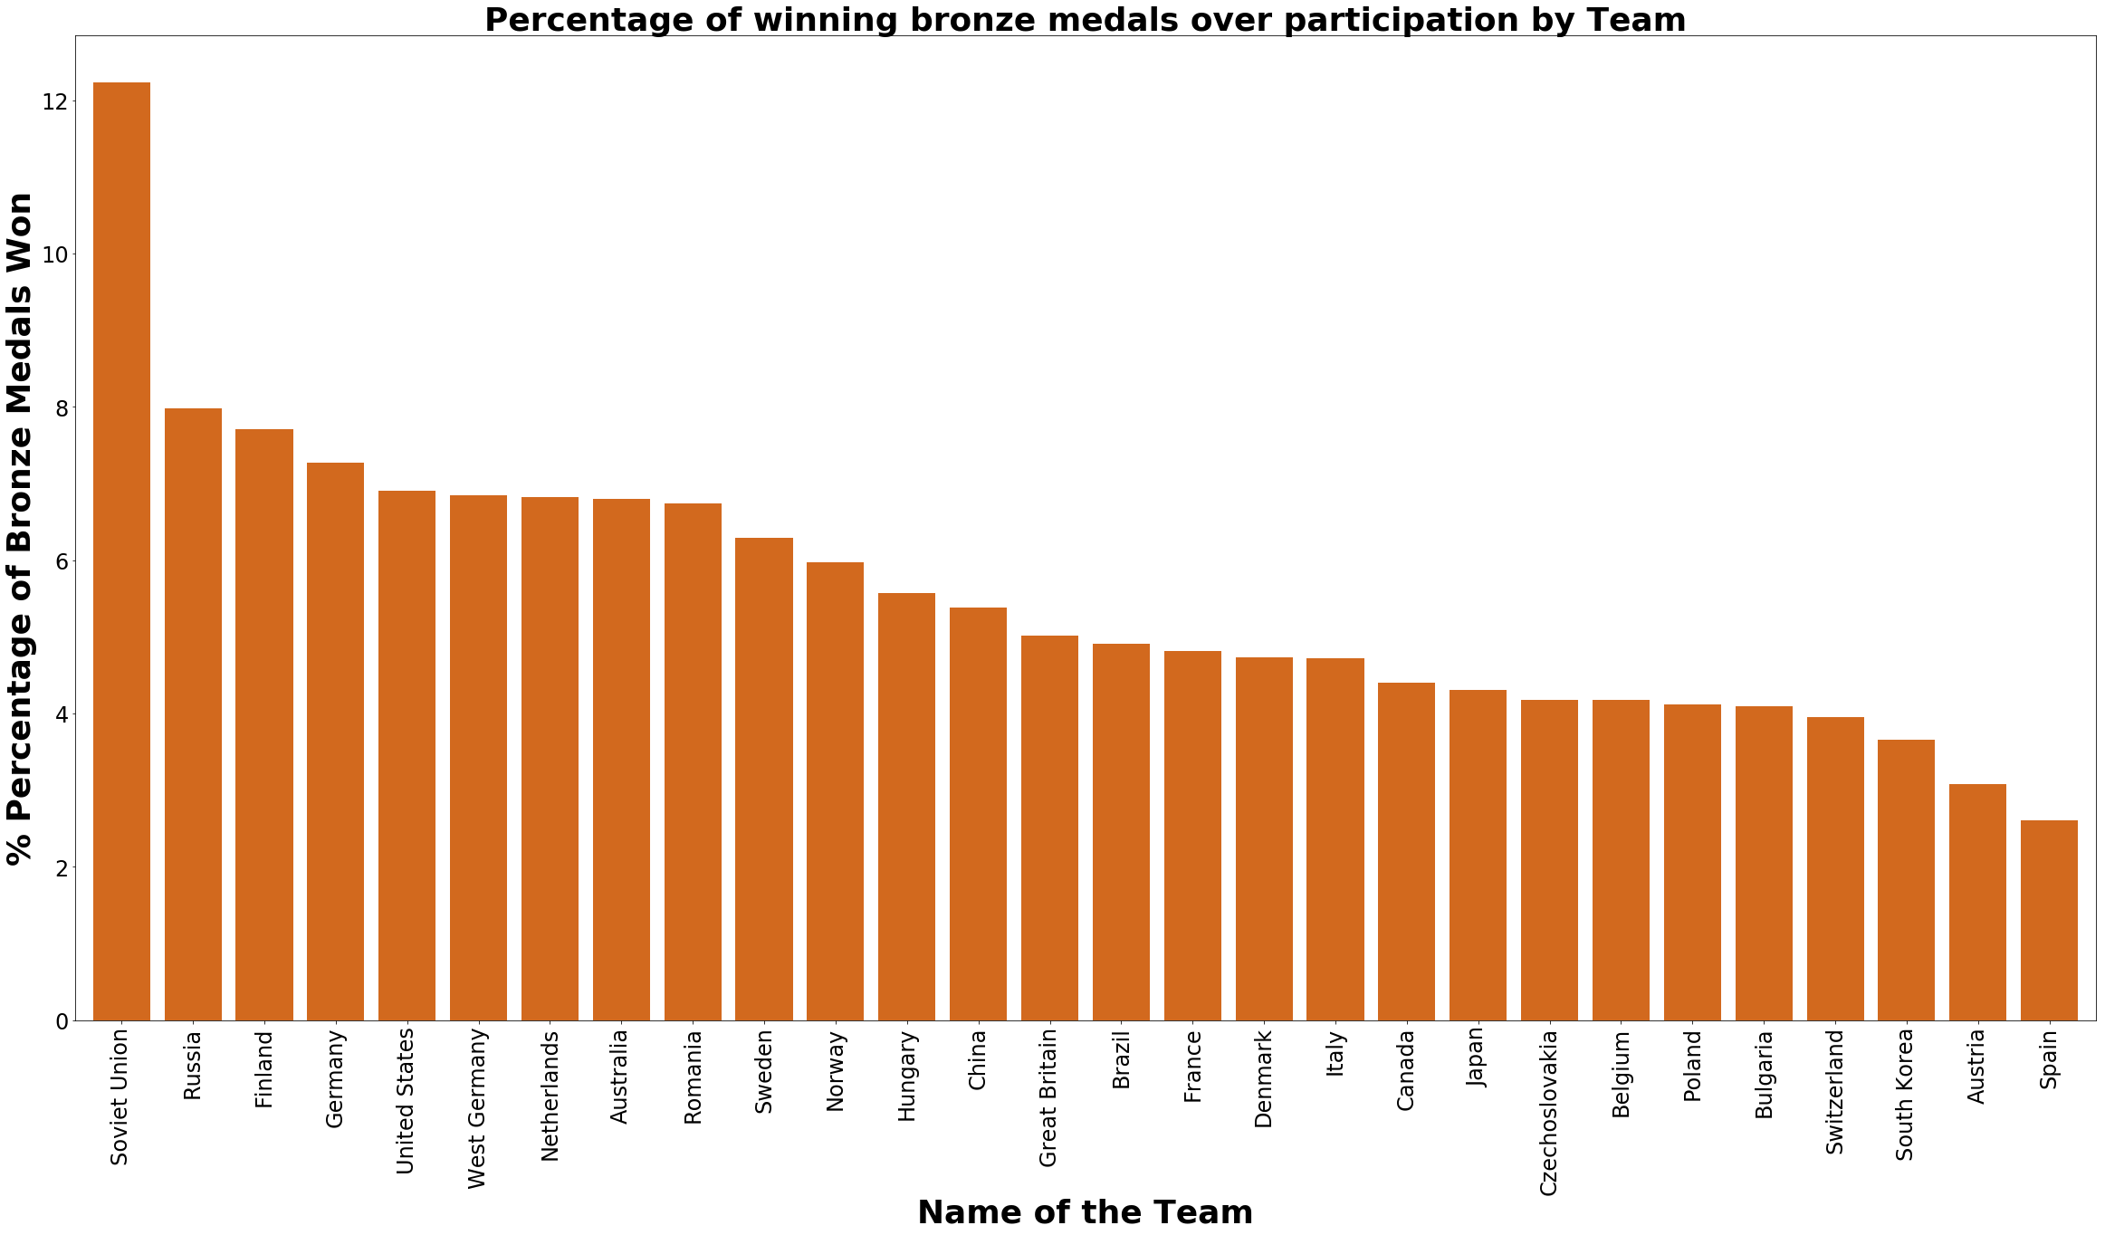

Slide 24
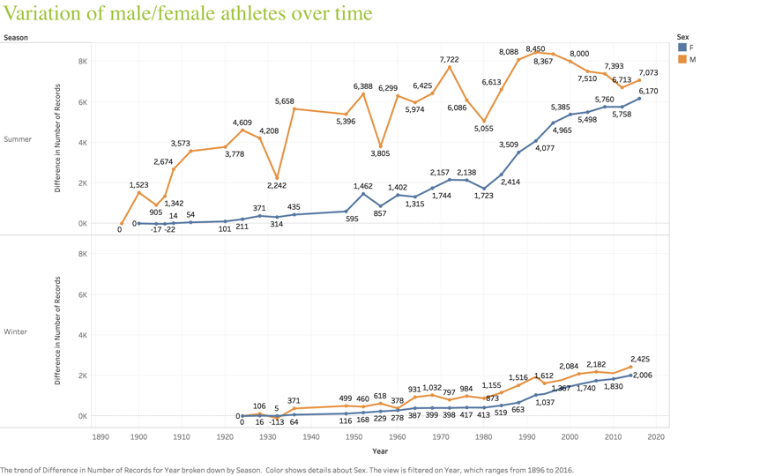

Slide 25
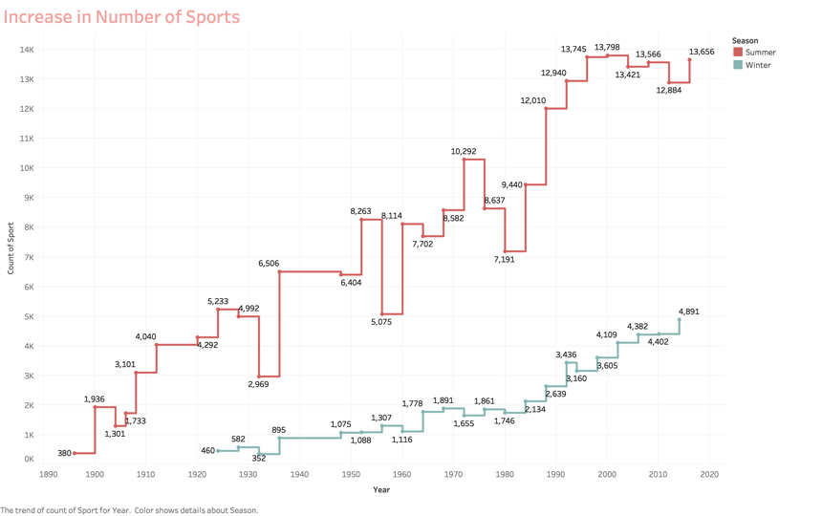

Slide 26
Variation of Participants over years
https://public.tableau.com/profile/manoj.kumar3772#!/vizhome/Analysis-on-Olympic-data/Variationofparticipation?publish=yes
Please navigate to this link and you can see a story of how number athletes participating over years created using Tableau.

Slide 27
Conclusion
This dataset provides an opportunity to know about how the Olympics have evolved over time, including participation and performance of athletes , different nations, different sports and events.

